Slide 1
Updated on October 6th 2020
Any questions, please reach out to khareash@

Slide 2

Amazon Comprehend
Discover Insights and Relationships in Text
Notes:
First call deck for introduction to Amazon Comprehend

Slide 3














The AWS ML Stack Broadest and most complete set of Machine Learning capabilities
AI SERVICES
 | VISION | SPEECH | TEXT | SEARCH | CHATBOTS | PERSONALIZATION | FORECASTING | FRAUD | DEVELOPMENT | CONTACT CENTERS
Amazon Rekognition
Amazon Polly
Amazon Transcribe
+Medical
Amazon Comprehend
+Medical
Amazon Translate
Amazon Textract
Amazon Kendra
Amazon Lex
Amazon Personalize
Amazon Forecast
Amazon Fraud Detector
Amazon CodeGuru
Contact Lens
For Amazon Connect
ML SERVICES
Ground Truth | AWS Marketplace for ML |  |  |  |  |  |  |  |  |  | Neo | Augmented AI
 |  | Built-in algorithms | Notebooks | Experiments | Processing | Model training & tuning | Debugger | Autopilot | Model hosting | Model Monitor
SageMaker Studio IDE
Amazon SageMaker
ML FRAMEWORKS & INFRASTRUCTURE
Deep Learning AMIs & Containers | GPUs & CPUs | Elastic Inference | Inferentia | FPGA
DeepGraphLibrary
Notes:
Now, at the top of the stack, we serve developers and companies who want to add solution-oriented intelligence to their applications through an API call rather than developing and training their own models in SageMaker. And we have a lot of services in this area to do specific things like:
Vision (Rek Image and video) “tell me what’s in this image,” “which celebrities are in this image,” and, “is this image safe for work?”
Speech – (Polly, Transcribe) – If you want to turn text into speech we have Polly, and if you want to transcribe audio we have Transcribe
Text (translate, comprehend, textract) – If you want to translate text to different languages we have translate, and if you want to understand what’s being said in those translated corpuses of text you have Comprehend, if you want to extract text from documents using OCR++, you have Textract.
Then you have the things which Amazon is relatively famous for. Alexa and chatbots with Lex, personalization, and forecasting
Customers have asked us to continue to consider adding services around areas where we have a lot of experience and data from our consumer business…
Amazon Fraud Detector, a new fraud management service for detecting online identify and payment fraud in real-time. No machine learning experience required.
Amazon CodeGuru, a new machine learning service to automate code reviews and identify your most expensive line of code.
Contact Lens for Amazon Connect provides machine learning powered contact center analytics for Amazon Connect
Kendra, a new service which reinvents enterprise search with machine learning.

Slide 4







Customer challenges with building NLP models
Data annotation
Machine learning skills
Labeled training data
Model training effort
Model management in production
Data collection and preparation
Training language models
NLP model
Notes:
There are a number of NLP tools available to customers. These tools can perform NLP functions such as identify entities, classify documents, and extract parts of speech from sentences. Even if open source or free, these tools or solutions come at a cost. In most cases, users need to know machine learning to be able to understand how the tools work.
First, they need to know what kind of training data they need to be able to train their own NLP models.
Then they need to collect data to train models. When training models from scratch, they need to collect thousands of examples to train models. Most customers find this step challenging as the quality of training data decides the accuracy of trained models.
Training models is not a single step process. Customers need to run multiple iterations, tweaking training data, modifying models, identifying algorithms that are more accurate for their data in each step. Again, each of these steps requires them to know machine learning.
Finally, when they have models in production, they need to ensure they continue to be relevant and accurate. As data changes, models tend to drift. Detecting sentiment in text becomes challenging as people derive new ways and choice of words to express their emotions. Organizations need to continuously collect new data and feed it into their models on a regular basis.
For business users and developers who are not data scientists, using NLP can become a daunting task. However, most of the use cases that need NLP do not need customers to build their own NLP models from scratch. They can use models that are pre-trained for their use cases and that offer simple API interfaces to use NLP. Amazon Comprehend does just that.

Slide 5
Amazon Comprehend
A fully managed and continuously trained service that discovers insights and relationships in text.
Notes:
Amazon Comprehend is a fully managed and continuously trained service that discovers insights and relationships in text using machine learning. Launched in 2017, Amazon Comprehend provides simple APIs that any developer can use to process text in many languages including English, French, Japanese, Chinese (simplified and traditional) and more.

Slide 6








Typical Amazon Comprehend use cases
Automation of email workflows
Customer sentiment analysis
Customer support tickets routing
Contact center call analysis
Personally Identifiable Information (PII) detection and redaction
Documents and media tagging
Document data extraction

Slide 7








Amazon Comprehend
Discover insights and relationships in text
Entities
Key Phrases
+ Custom Entities
PII
(Personally Identifiable Information)
Sentiment
Documents
Email, chat, social, phone calls and more
Amazon
Comprehend
Automatically extract insights from text
Document Classification
Topics
Language
Syntax
Notes:
Amazon Comprehend has pre-trained models that identify entities such as places, people, brands, or events; determine the language of the text; extract key phrases; understand how positive or negative the sentiment of text is; and automatically organize a collection of text files by topic.
However, customers have data that contains text that is very specific to their organization or business. They could have specific product names or document types. Therefore customers can train Comprehend to extract customer-specific entities or to assign specific labels to documents.
Vision Critical provides a customer relationship intelligence software that enable large enterprises to be fast, responsive, and customer-centric. By integrating with Amazon Comprehend’s sentiment analysis, their platform turns qualitative customer feedback into actionable insight, determining whether their feedback is positive, negative, or neutral at over 90% accuracy.
LexisNexis uses Comprehend’s custom entities recognition models to discover insights from legal documents. Entities such as judge and attorney, can be identified quickly from over 200 million documents at above 92% accuracy.

Slide 8
Entity Detection
Amazon.com, Inc. is located in Seattle, WA and was founded July 5th, 1994 by Jeff Bezos. Known to the most customer obsessed organization, it welcomes thousands of customers and partners to one of its flagship events AWS re:Invent every year.
Amazon.com, Inc.
Entity: ORGANIZATION
Seattle, WA
Entity: LOCATION
July 5th, 1994
Entity: DATE
Jeff Bezos
Entity: PERSON
thousands of customers
Entity: QUANTITY
re:Invent
Entity: EVENT

Slide 9
Key Phrase Detection with Amazon Comprehend
Hello John. Your AnyCompany Financial Services, LLC credit card account 1111-0000-1111-0000 has a minimum payment of $24.53 that is due by July 31st. Based on your autopay settings, we will withdraw your payment on the due date from your bank account XXXXXX1111 with the routing number XXXXX0000.
Your latest statement was mailed to 100 Main Street, Anytown, WA 98121.
After your payment is received, you will receive a confirmation text message at 206-555-0100.
If you have questions about your bill, AnyCompany Customer Service is available by phone at 206-555-0199 or email at support@anycompany.com.

Slide 10

PII Detection
Hi, my name is John Doe. For verification, the last 4 digits of my social are 6789 and my dob is 01/01.
I paid for my credit card 1111-0000-1111-0000 last week from my bank account XXXXXX1111 with the routing number XXXXX0000. The check was mailed from 100 Main Street, Anytown, WA 98121.
Please confirm receipt by calling me at 206-555-0199 or emailing at john.doe@anycompany.com.
John Doe
Entity: NAME
6789
Entity: SSN
01/01
Entity: DATE_TIME
1111-0000-1111-0000
Entity: CREDIT_DEBIT_NUMBER
XXXXXX1111
Entity: BANK_ACCOUNT_NUMBER
XXXXX0000
Entity: BANK_ROUTING
100 Main Street, Anytown, WA 98121
Entity: ADDRESS
206-555-0199
Entity: PHONE
john.doe@anycompany.com
Entity: EMAIL

Slide 11
PII handing options: Detect, Redact, Mask
Detect
Redact
Mask
Hi, my name is John Doe. For verification, the last 4 digits of my social are 6789 and my dob is 01/01.
I paid for my credit card 1111-0000-1111-0000 last week from my bank account XXXXXX1111 with the routing number XXXXX0000. The check was mailed from 100 Main Street, Anytown, WA 98121.
Please confirm receipt by calling me at 206-555-0199 or emailing at john.doe@anycompany.com.
Hi, my name is [NAME]. For verification, the last 4 digits of my social are [SSN] and my dob is [DATE_TIME].
I paid for my credit card [CREDIT_DEBIT_NUMBER] last week from my bank account [BANK_ACCOUNT_NUMBER] with the routing number [BANK_ROUTING]. The check was mailed from [ADDRESS].
Please confirm receipt by calling me at [PHONE] or emailing at [EMAIL].
Hi, my name is ********. For verification, the last 4 digits of my social are **** and my dob is *****.
I paid for my credit card ******************* last week from my bank account ********** with the routing number **********. The check was mailed from *************************.
Please confirm receipt by calling me at ************ or emailing at ***********************.

Slide 12



Two Modes of Operation
English; additional languages based on customer feedback
US based PII; expanding to EU and APAC post-launch
Asynchronous
Real time/ Synchronous
Redaction & Masking
Extraction
Extraction

Slide 13
PII Elements Detected
PII entity category | PII entity types
Financial | BANK_ACCOUNT_NUMBER BANK_ROUTING CREDIT_DEBIT_NUMBER CREDIT_DEBIT_CVV CREDIT_DEBIT_EXPIRY PIN
Personal | NAME ADDRESS PHONE (10 digits) EMAIL AGE
PII entity category | PII entity types
Technical security | USERNAME PASSWORD URL AWS_ACCESS_KEY AWS_SECRET_KEY IP_ADDRESS MAC_ADDRESS
National | SSN PASSPORT_NUMBER DRIVER_ID
Other | DATE_TIME
For each detected PII entity, you get the type of PII, a confidence score, and beginning and ending offset.

Slide 14
Topic Modeling
Discover common themes in a corpus of documents.
Keywords Topic Groups
Document Relationship to Topics
Topic | Term | Weight
0 | Washington | 0.89
1 | Silicon Valley | 0.67
2 | Roasting | 0.91
Document | Topic | Proportion
Doc1.txt | 0 | 0.89
Doc1.txt | 1 | 0.11
Doc2.txt | 2 | 0.47
Doc2.txt | 1 | 0.99
Doc3.txt | 2 | 0.55
Doc3.txt | 0 | 0.45
Notes:
Customers can also use Amazon Comprehend to examine a corpus of documents to organize them based on similar keywords within them. Document clustering (topic modeling) is useful to organize a large corpus of documents into topics or clusters that are similar based on the frequency of words within them.
Topic modeling is a asynchronous process. Customers can submit a set of documents for processing and then later get the results when processing is complete.
Customers use topic modeling to surface common topics in large repositories of documents.

Slide 15
Custom Comprehend Custom Classifiers & Custom Entity Recognizers
Notes:
Comprehend can be trained to work with organization’s specific data that Comprehend has not processed before. Customers can train Comprehend to assign labels to text and to extract custom entities in addition to the 9 entity types detected by pre-trained model.

Slide 16






Custom Classification
Loyalty program
Triage support tickets
Organize customer feedback
Pricing
Moderate forums
Classify internal documents
Technical support
Notes:
Our customers want the accuracy of Comprehend to now support their own organization labels, terms and phrase. Consider a company that wants to understand which department to direct their unstructured data to:
Loyalty program department
Payments department
Tech support
What are most important use cases for customization?
Organizing documents based on their content
Analyzing documents looking for business-specific terms and phrases

Slide 17

Training Custom Classifiers
Label | Text
PRICING | The service is too expensive
TECHNICAl_SUPPORT | I cannot log in
LOYALTY_PROGRAM | My points are not being applied correctly”
1
2
3
Label
CSV file with training data
Train
Auto algorithm selection
Auto tuning and testing
SDK or Console
Classify
Asynchronous or real time
Build applications on top
For each class, minimum of 10 documents required for training. For more accurate training, at least 50 documents or more for each class recommended.
Notes:
Using custom classification is easy
1. Create a CSV file with examples of text and the applicable label
2. Train a custom model using your training data
3. Run inference jobs asynchronously or synchronously (new)
Training a custom classifier is easy. Customers simply need to create a CSV (comma separated values) file with two columns. The first column should contain labels with respective example training text in the second column as shown here. Customers then need to place the CSV file in an S3 bucket and start a classifier training job after providing some simple parameter values. The training job returns accuracy metrics that tell how well the classifier model was trained. Customers can compare actual labels provided by a human versus labels predicted by Comprehend to determine model accuracy. This also tells a user what classes may require additional training data.
Comprehend uses multiple algorithms in the training process and picks the model that delivers highest accuracy for the training data. This way, users need not deal with complexities of choosing different algorithms, running iterations, and determining the best ensemble of algorithms. They simply need to provide training text and Comprehend does the rest.
Once a model is trained, users can reference it by name and run inference jobs either synchronously or asynchronously.

Slide 18

Custom Classifier types
Pricing
Adventure
Loyalty Program
Comedy
Technical Support
Drama
Multi-class
Multi-label
Classes are mutually exclusive
Classification into one class
Each model allows 1000 classes
Classes are not mutually exclusive
Classification into one or more classes
Each model allows 100 unique classes
Notes:
Customers use Custom Classification for use cases such as - automatically routing support tickets to teams who can resolve them faster, categorizing emails into support requests and sales orders, and separating out customer feedback by different products.
Customers can train two types of classifiers. Using a multi-class classifier, text can be categorized into one of many mutually exclusive classes. With multi-label classifier, multiple labels can be associated with the same text.
A single multi-class classifier model can categorize text into 1000 classes.
What makes Comprehend custom classifier easy to adopt is that customers can train a model by providing as little as 50 examples of each class. We have business users who have used AWS Management Console to train custom classifiers and run inference jobs without any help from any developer or data scientist.
Customers use custom classifier in production for large classification use cases. A global consumer durables manufacturer analyzes description text for thousands of videos to categorize videos into about 3000 categories using a series of custom classifier models trained in Comprehend. Customers also use classification to identify document types to determine what entities they might contain and extract them using entity recognition.

Slide 19


Custom Entities
Analyze documents for your business and industry terms
Bring your own schema to unstructured text analytics
”I never received the shipment for part number XT1764PY98”
XT1764PY98: PART_NUMBER
“Trading of ETFs was halted today”
ETF: INVESTMENT_VEHICLE
“I liked the shwarma but loved the hummus”
shwarma, humus: MENU_ITEMS
Notes:
Customers who would like to extract entities that are not detected by the pre-trained entity detection API can do so with custom entity detection API. Customers use this API in a number of interesting use cases such as
Automated extraction of data from emails
Extraction of data from financial documents such as insurance contracts, mortgage documents, county records
Processing of legal documents to extract legal data from contracts
Extraction of PII (Personally Identifiable Information) and downstream redaction

Slide 20
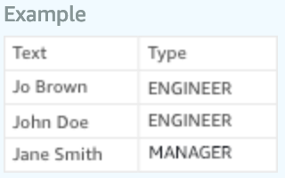
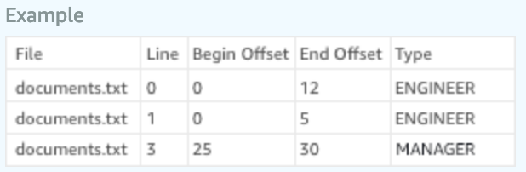
Training data for Custom Entity Recognizers
OR
Using entity list and training docs
Using annotations and training docs
1
2
Simple and fast
Specify entity values that are present in the training documents
May have poor accuracy if different entity types have same values or values in wrong context are selected for training
Specify document offset for values present in the training documents
Higher annotation effort
Higher accuracy as only specific values in the desired context are selected for training
Notes:
Just like training a classifier, training a custom entity recognizer requires a CSV file that provides annotated training data.
Again, with the intent of making it easy for a developer to use the service, Comprehend simplifies custom entity recognizer training. There are two ways to create training data.
Entity List: This is an easy and fast way of training Comprehend ER. Customers simply create a CSV file with two columns. The first one contains the actual value of an entity type that exists in training documents. The second column contains the respective entity type. Customers then upload their example training documents in an S3 bucket and start a training job. Comprehend then picks up the values in the CSV file, locates them in the training documents in S3 bucket and trains on the context of the entity types. While this process is easy, sometimes it leads to accuracy issues if the values provided for one entity type exists for another entity type as well. Therefore, Comprehend offers another way of preparing training data that is more accurate.
The other way of training is using Annotations. In this approach, a user does not provide the actual entity values but specifies the actual offset of example entity values in training documents. This is done by specifying the line number, starting point, and ending point for example entity types in the training documents. So if there are two people with the same name John Doe – one an engineer and another a manager, a user can now specify who is who in their annotation file. The rest of the training process is the same as entity list approach.
This technical nuance is important as it has been found to create accuracy issues for customers who choose to train a model using entity list, not realizing their data was not suited for this approach.

Slide 21
Automated Custom Entity Recognizer Training
1
Prepare examples
2
Train the service
3
Analyze
Entity List
Hello, my name is John Doe, and thank you for calling AnyCompany. I understand you are calling about part number XT2457. We have that part on back order and we are expediting it for you.
Thank you, but I was expediting it last week. At this point I think we should go ahead and cancel the order entirely.
We are sorry to hear that sir, would you be willing to complete the order if we offered a 10% discount?
Yes, thank you.
ENTITY VALUE | ENTITY TYPE
XT2457 | PART
Renew Subscription | ACTION
SD5578 | PART
Cancel the order | ACTION
+
Automated annotation
Automated algorithm selection
Automated tuning and testing
SDK or code-free Console UX
Documents containing terms and phrases in text
200 examples per entity type recommended
Notes:
Each custom entity recognizer model supports 12 entity types. It is recommended that users provide 200 examples of each entity type when training custom ER.
Once a model is trained, users can reference it by name and run inference jobs either asynchronously.
Custom entity recognition does not support synchronous API at the moment.
Customers can train custom Comprehend models using AWS Management Console, using CLI, or SDK.

Slide 22
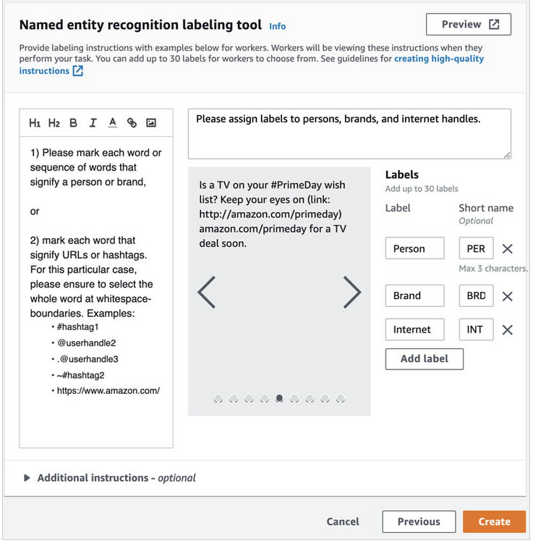
Annotating training data with SageMaker Ground Truth
End-to-end labeling pipeline from documents upload, workforce selection, work delegation, and labeling
Driven through a simple user interface
Choice of leveraging internal team or third-party workforce to annotate data
Notes:
Customers can now leverage Amazon SageMaker Ground Truth to annotate data to train Comprehend custom entity recognizer models. They can manage the data labeling pipeline using Ground Truth features with choice of using their internal labeling workforce if the data is sensitive. For large volumes of non-sensitive data, they can leverage third party labeling workforce that offers speed in labeling at low cost. The output of Ground Truth labeling job can be fed into Comprehend’s custom entity recognition training job.

Slide 23
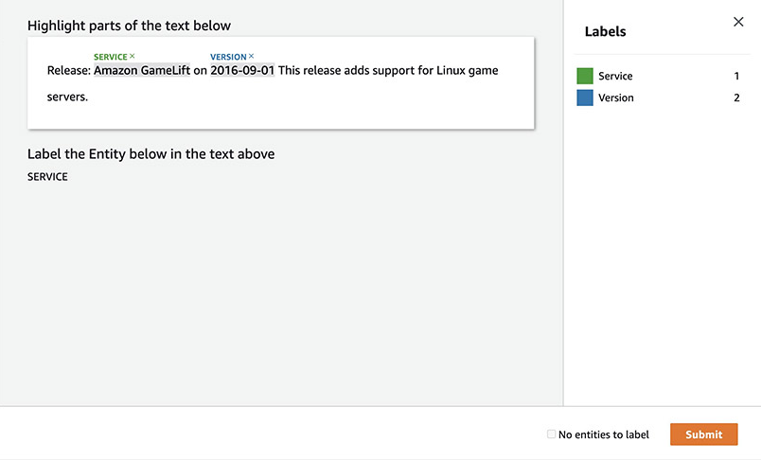
Human validation with Amazon Augmented AI for near-100% accuracy use cases
Put models to production faster with a human reviewer. Use human validation to continuously improve ML model
Reduced time-to-market with pre-built workflows, user interfaces, multiple workforce options (internal team or third-party workforce)

Slide 24




Real-time custom classification and custom entity recognition
Synchronous endpoints for custom classifier and custom entity recognizer models
Endpoints offer configurable throughput to match data volume starting at 100 characters per second
Endpoints can autoscale with volume or can be scheduled to turn on at specified times
Pricing based on endpoint throughput and uptime duration
Notes:
Synchronous classifier enables customers who need to run custom classification inference jobs in real time. They may want to do so to categorize incoming chat messages while a customer is waiting. Customers with business process with stringent email response SLAs also prefer to use synchronous custom classification.
Its important to note that the method of creating classifiers remains the same in both synchronous and asynchronous consumption methods. Synchronous classifiers need a user to create an endpoint before they can make real time inferences with their custom models. This endpoint is dedicated to the users custom model and is charged to them on endpoint size and for the duration they are on. The size of an endpoint is based on the amount of data it can process per second starting with 100 characters per second. These endpoints can auto-scale based on the volume of incoming data.

Slide 25
Amazon Comprehend safeguards your data
Amazon Virtual Private Cloud (Amazon VPC) endpoints via AWS PrivateLink: Securely initiate API calls to Amazon Comprehend from within your VPC and avoid using the public internet
Amazon Key Management Service (KMS): Enables you to encrypt the data in the storage volume for Start* and Create* jobs as well as encrypt the output results of Start* jobs using your own KMS key

Slide 26
Comprehend Languages Support
Languages | Entities, Key Phrases, Sentiment | Syntax | Custom Classifier | Custom Entity
English (en) | ✓ | ✓ | ✓ | ✓
Spanish (es) | ✓ | ✓ | ✓ | ✓
French (fr) | ✓ | ✓ | ✓ | ✓
German (de) | ✓ | ✓ | ✓ | ✓
Italian (it) | ✓ | ✓ | ✓ | ✓
Portuguese (pt) | ✓ | ✓ | ✓ | ✓
Arabic (ar) | ✓
Chinese - traditional (zh-TW) | ✓
Chinese – simplified (zh) | ✓
Hindi (hi) | ✓
Japanese (ja) | ✓
Korean (ko) | ✓
Notes:
Comprehend supports entity detection, key phrase detection, and sentiment analysis natively in 12 languages listed here. It supports custom classification and custom entity recognition in English, Spanish, French, German, Italian, and Portuguese.
Customers who need to analyze text in languages not supported by Comprehend can leverage Amazon Translate to convert text into a supported language before processing with Comprehend.

Slide 27


Accelerating investigation timelines
FINRA uses Amazon Comprehend to process and review millions of documents with unstructured data, helping flag records of interest that should be reviewed by human investigators.
Notes:
FINRA is a not-for-profit organization authorized by Congress to protect America’s investors by making sure the broker-dealer industry operates fairly and honestly.
FINRA receives millions of documents with unstructured data to support investigative, examination, and compliance processes. Previously, investigators and examiners had to manually go through documents page by page to find what they needed.
FINRA uses Amazon Comprehend to quickly extract names of individuals and organizations, and match extracted entities to FINRA records, flag individual of interest, generate summaries, and detect similarities with other documents.
This exponentially increases the scope of investigations while shortening the time to conclusion.

Slide 28


Acting on customer feedback
Bark & Co uses Amazon Comprehend to analyze their customers’ comments and feedback, allowing them to respond faster and improve the customer experience.
Notes:
Bark & Co is the parent company for BarkShop, an ecommerce site for dog treats and products, and BarkBox, a monthly pet subscription box.
Their engineering team wanted to ensure colleagues were correctly understanding the sentiment of their customers’ comments and feedback.
To do this, the company started using AWS Comprehend to analyze the custom, text-written responses they were receiving and were consequently able to better gauge what their pet-loving base was trying to say.
This has allowed them to respond faster to customer requests and feedback, improving the customer experience.

Slide 29


Finding insights in social data
PubNub uses Amazon Comprehend to analyze twitter posts using election related hashtags, creating new insights on public reaction to political events.
Notes:
PubNub is a global Data Stream Network and realtime infrastructure-as-a-service company based in San Francisco, California.
They wanted a scalable way to run the sentiment analysis from unstructured text.
Using Amazon Comprehend, they are running sentiment analysis on all Twitter feeds that mention #Midterms2018 to create insights on how people are feeling about this year's midterm.
This helped create new engagements with their developer community.
(https://www.pubnub.com/sentiment-analysis-machine/).

Slide 30
Getting started
Know more about Amazon Comprehend

Slide 31
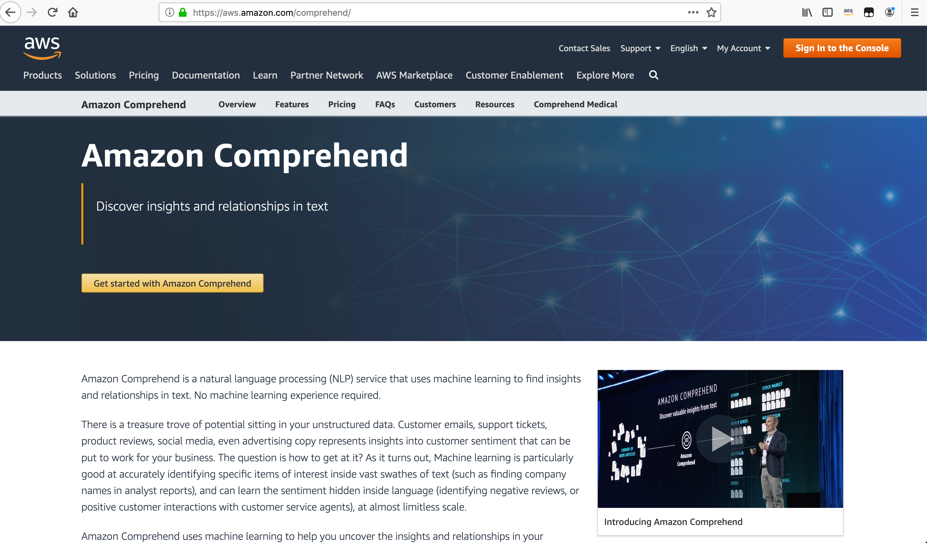
https://aws.amazon.com/comprehend/

Slide 32
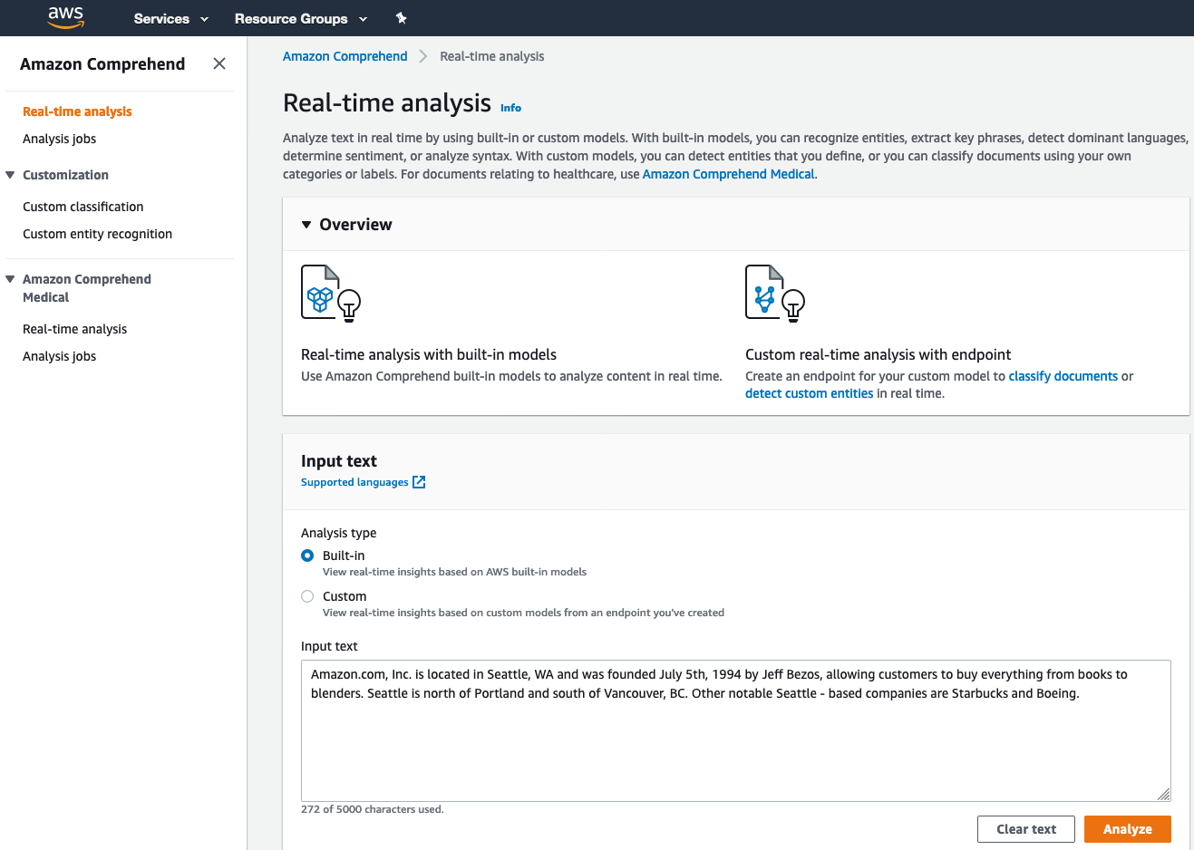
Get started: AWS Console

Slide 33
Amazon Comprehend aws.amazon.com/comprehend
Thank you

